Slide 1
Systems Analysis and Design Documentation, Deployment and Release management

Slide 2
INTRODUCTION
The implementation phase consists of developing and testing the system’s software, documentation, and new operating procedures.
Managing the programming process is the major task of the systems analyst in this phase.
While programmers work on programming, the systems analyst design a variety of tests to ensure that the system does what it was designed to do.
During this phase, the systems analysts finalize the system documentation and develop the user documentation.

Slide 3
DEVELOPING DOCUMENTATION
There are two fundamentally different types of documentation:
- system documentation is intended to help programmers and systems analysts understand the system and enable them to build it or maintain it;
- user documentation is designed to help the user operate the system.

Slide 4
On-line documentation
There are four key strengths of online documentation:
- Simpler searching
- Different representation
- User Interaction
- less expensive

Slide 5
Documentation Requirements
General requirements of all software documentation
Should provide for communication among team members
Should act as an information repository to be used by maintenance engineers
Should provide enough information to management to allow them to perform all program management related activities
Should describe to users how to operate and administer the system

Slide 6
Documentation Requirements
In all software projects some amount of documentation should be created prior to any code being written
Design docs, etc.
Documentation should continue after the code has been completed
User’s manuals, etc.

Slide 7
Types of Documentation
There are two fundamentally different types of user documentation:
- Process Documents
- Product Documents

Slide 8
Process Documentation
Used to record and track the development process
Planning documentation
Cost, Schedule, Funding tracking
Schedules
Standards
Etc.

Slide 9
Process Documentation
Has a relatively short lifespan
Only important to internal development process
Except in cases where the customer requires a view into this data
Some items, such as papers that describe design decisions should be extracted and moved into the product documentation category when they become implemented

Slide 10
Product Documentation
Describes the delivered product
Must evolve with the development of the software product
Two main categories:
System Documentation
User Documentation

Slide 11
Product Documentation
System Documentation
Describes how the system works, but not how to operate it
Examples:
Requirements Spec
Architectural Design
Detailed Design
Commented Source Code
Including output such as JavaDoc
Test Plans
Including test cases
V&V plan and results
List of Known Bugs

Slide 12
Product Documentation
User Documentation has two main types
End User
System Administrator
In some cases these are the same people
The target audience must be well understood!

Slide 13
Product Documentation
There are five important areas that should be documented for a formal release of a software application
Functional Description of the Software
Installation Instructions
Introductory Manual
Reference Manual
System Administrator’s Guide
Notes:
These do not necessarily each have to have their own document, but the topics should be covered thoroughly

Slide 14
Document Quality
Providing thorough and professional documentation is important for any size product development team
The problem is that many software professionals lack the writing skills to create professional level documents

Slide 15
Document Structure
All documents for a given product should have a similar structure
A good reason for product standards
The IEEE Standard for User Documentation lists such a structure
It is a superset of what most documents need
The authors “best practices” are:
Put a cover page on all documents
Divide documents into chapters with sections and subsections
Add an index if there is lots of reference information
Add a glossary to define ambiguous terms

Slide 16
Standards
Standards play an important role in the development, maintenance and usefulness of documentation
Standards can act as a basis for quality documentation
But are not good enough on their own
Usually define high level content and organization
IEEE
Has a published standard for user documentation
Provides a structure and superset of content areas
Many organizations probably won’t create documents that completely match the standard

Slide 17
Online Documentation
Either internal to the application or Web based
Requires rethinking the presentation style since normal “paper” documentation approaches do not carry over well
Should act as a supplement to paper documentation
Biggest benefit of Web docs are that they are always current

Slide 18
Document Preparation
Covers the entire process of creating and formatting a document for publication
Author recommends using specialized (and separate) tools for creating and preparing documents
This is only important for user documentation
It is often important to have a professional writer or document publisher evaluate documents before publication to ensure they look good and will carry over to paper well

Slide 19
Document Storage
Author Recommends (in 2001)
File System to store the actual documents
Database to store references to the files with metadata to allow searching and referencing
Today it is probably better to use a content management systems
CVS or Subversion
Free and Open Source
Easy to setup and maintain

Slide 20
Conclusion
Good overview of documentation
Though most documentation “requirements” are based on contract requirements
Hard to cover things like that in a paper like this
Most of the content seemed to be referring to user documentation
Design and other similar docs (often times more graphical than textual) were overlooked

Slide 21
System deployment

Slide 22
System deployment
It is the process that covers post-development activities like-
Configuration
Release
Installation
Updating
Adapting
Reconfiguration
Uninstallation

Slide 23
Traditional software deployment methods
The foot and hand model
Run around on foot and install software by hand.
Only viable for small client base.
Expensive for the companies.
The self-service model:
The end users install the software themselves.
Scales well.
Low costs for the company.
Becomes difficult as the complexity of installation and configuration increases.

Slide 24
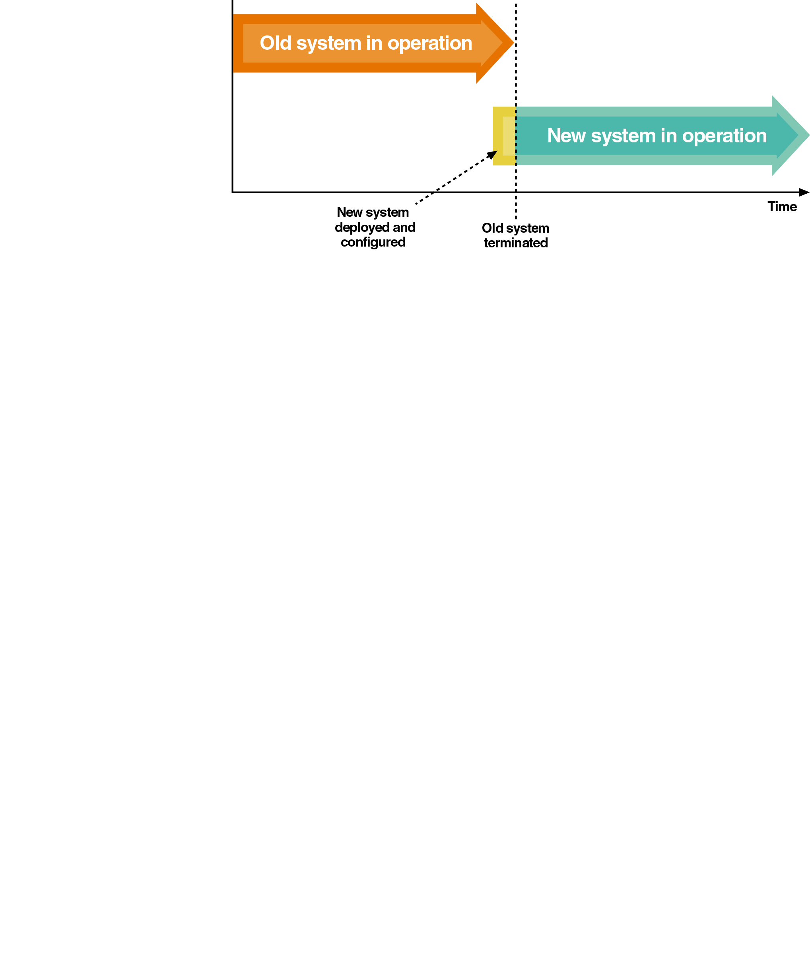
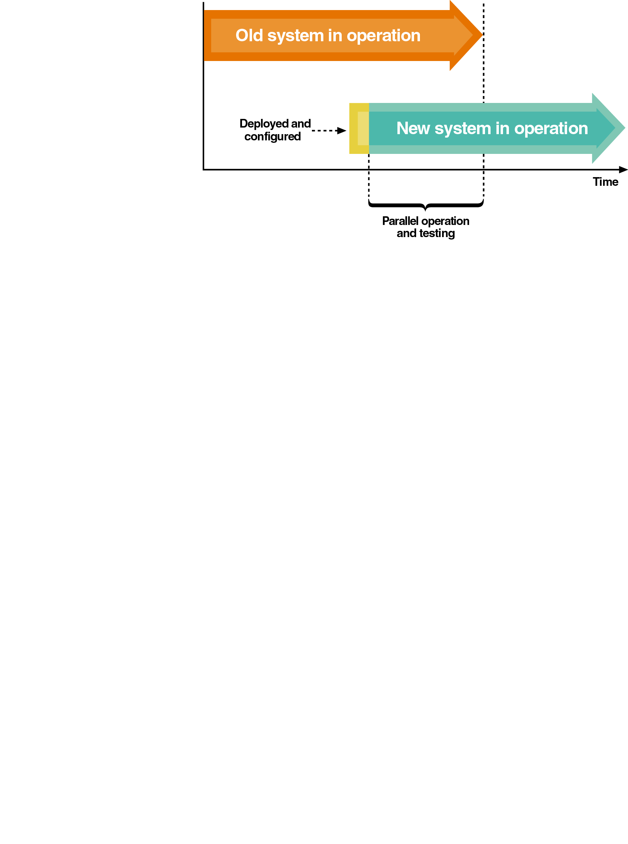
Deployment strategy
Structured methodology
Direct deployment
(“Cold Turkey”)
Parallel deployment

Slide 25
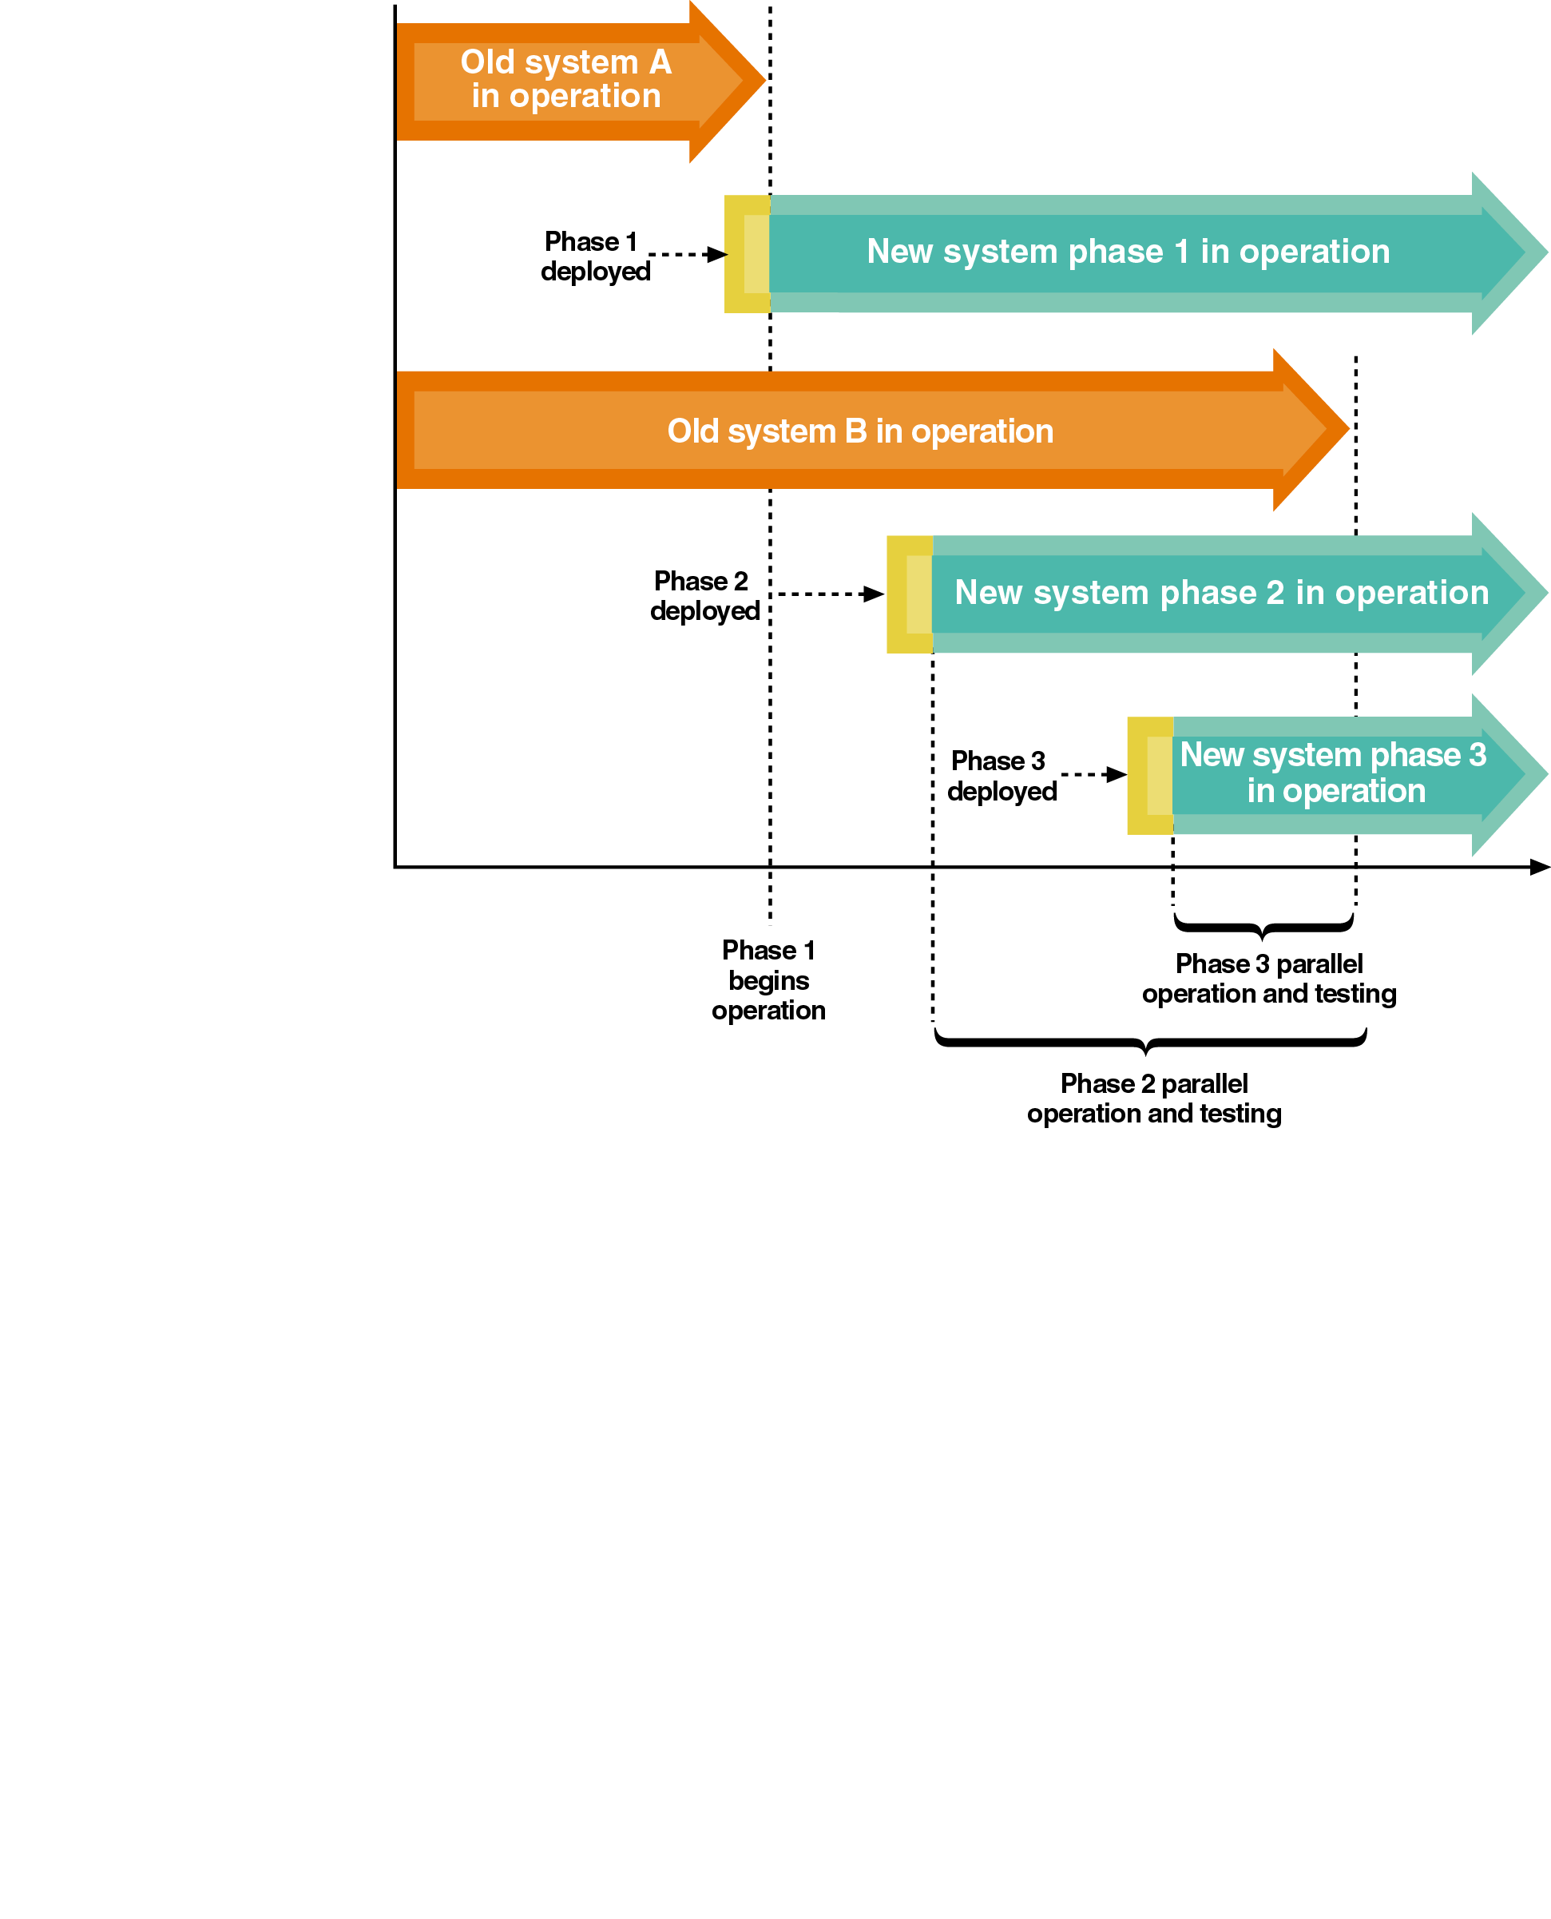
Deployment strategy
Phased deployment

Slide 26
Requirements of solution for software deployment
Incremental updates
Versioning
Automatic installation and configuration
Centralized Inventory
Decentralized Control
Security
Scalability
Support for heterogeneous environments
Live Updates
Licensing

Slide 27
Software deployment life cycle
Producer-side processes
Release
Retire
Customer-side processes
Install
Activate
Deactivate
Reconfigure
Update
Adapt
Remove
Notes:
The Software Deployment Life Cycle is an evolving collection of processes. These processes can either be performed on the software producer side or the customer side.

Slide 28
Challenges
Deployment of Windows Software
Reliable - installs properly or returns error report
Effective - fast, without user intervention and frustration
Automated - remotely managed, rebuild easily
Targeted - able to add software packages to specific group
Upgradeable - able to manage and deploy software upgrades
Removable - able to remove software reliably
Secure - must expose no new security risks
Notes:
Functionality: Software deployments can yield more than improving security, as adding new features that address specific business needs can help enhance employee productivity and streamline workflows by removing friction.
Patches: No application is infallible or impervious to outside intrusion. And the longer a particular release remains deployed without an update, the more likely security exploits are inviting an outside attack.

Slide 29
Possible Solutions
Manual installation
RoboCopy
Active Directory Group Policy Objects
Third party commercial solutions
Open Source solutions
Notes:
Robocopy, for "Robust File Copy", is a command-line directory and/or file replication command for Microsoft Windows.
Microsoft’s Group Policy Object (GPO) is a collection of Group Policy settings that defines what a system will look like and how it will behave for a defined group of users.
Having regular third-party penetration testing, an intelligent alert system, and subsequent software improvements at timely intervals help maintain security and mission-critical objectives with software deployments.

Slide 30
Software versioning
Alpha version
Test version that is incomplete but ready for some level of testing; dummy data used
Beta version
Test version that is stable enough to be tested by end users for an extended period of time; real data used
Production version
System version that is formally released in the to users

Slide 31
End of System deployment

Slide 32
Software release management

Slide 33
What is Release Management?
Release Management is the process of planning, building, testing and deploying hardware and software and the version control and storage of software.
Its purpose is to ensure that a consistent method of deployment is followed. It reduces the likelihood of incidents as a result of rollouts and ensures that only tested and accepted versions of hardware and software are installed at any time.

Slide 34
Why use Release Management?
The opportunity to plan expenditure and resource requirements in advance
A structured approach to rolling out all new software or hardware, which is efficient and effective.
A changes to software are ‘bundled’ together for one release, which minimizes the impact of changes on users.
Testing before rollout
Ensuring that correct versions are installed at all times

Slide 35
Goals of Release Management
Release management is geared toward five goals:
Mitigate risk throughout the software delivery life cycle (SDLC)
Align all teams involved in the release
Streamline the development and release processes
Meet deadlines consistently
Align development goals with business goals

Slide 36
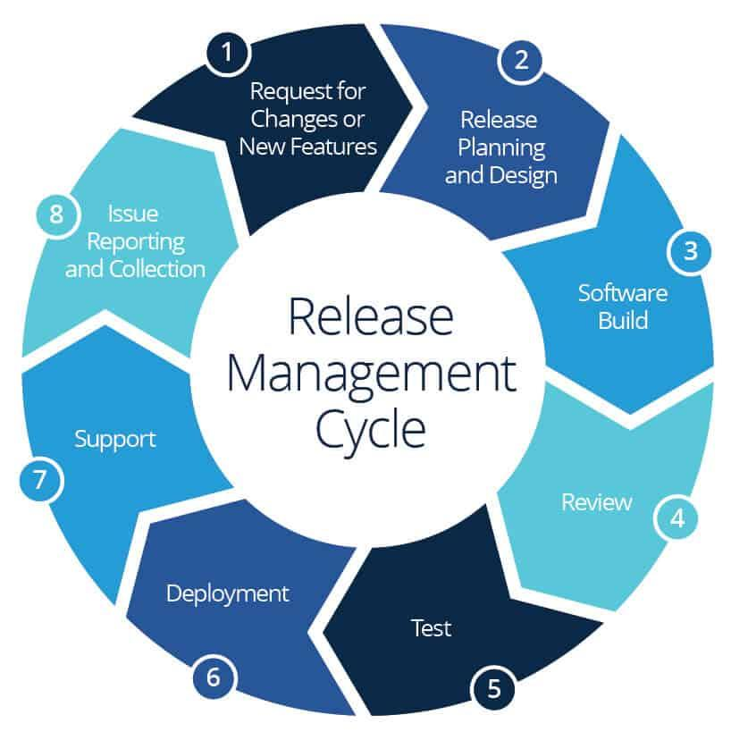
The Cycle of Release Management

Slide 37
Release planning
Design
Architecture of a new ICT service. That is the configuration of the pieces of hardware and software involved.
Build
Build is the compilation of components to form the service.
Test
Test is the internal technical support testing.
Acceptance testing
Acceptance testing is functionality testing

Slide 38
Release Policy
1. Roles &
Responsibilities
8. Business critical
times & risks
2. Levels of
Authority
3. Identification
& Packaging
Release
policy
7. Emergency
change
4. Release
unit - full/delta
6. Release
frequency
5. Release
numbering

Slide 39
Key roles in the release management process
Release manager - A release manager sets the pace for software rollouts and ensures customers have all the resources they need.
Product owner - Establishing the requirements and acceptance criteria.
Quality manager - Oversees testing to determine whether software passes acceptance criteria without false positives or negatives.
DevOps team - Controls the entire lifecycle of a feature from design to development to production support.

Slide 40
End of Release management

